Slide 1
COMPUTER HARDWARE

Slide 2
TYPES OF UNITS
OUTPUT DEVICES
INPUT DEVICES
MEMORY UNITS
ALU
SECONDARY STROAGE UNITS
CPU

Slide 3
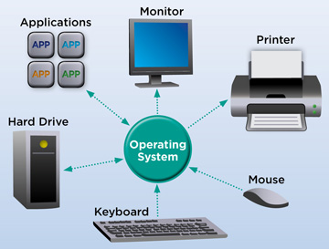
CPU
central processing unit (CPU), principal part of any digital computer system, generally composed of the main memory, control unit, and arithmetic-logic unit.
CPU acts like brain and nervous system to serve the computer.

Slide 4
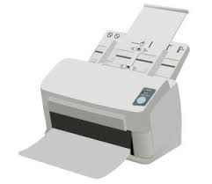

OUTPUT DEVICES
An output device is any peripheral that receives data from a computer, usually for display, projection, or physical reproduction.
Examples:
1.Printer
2.Monitor
3.Headphones

Slide 5

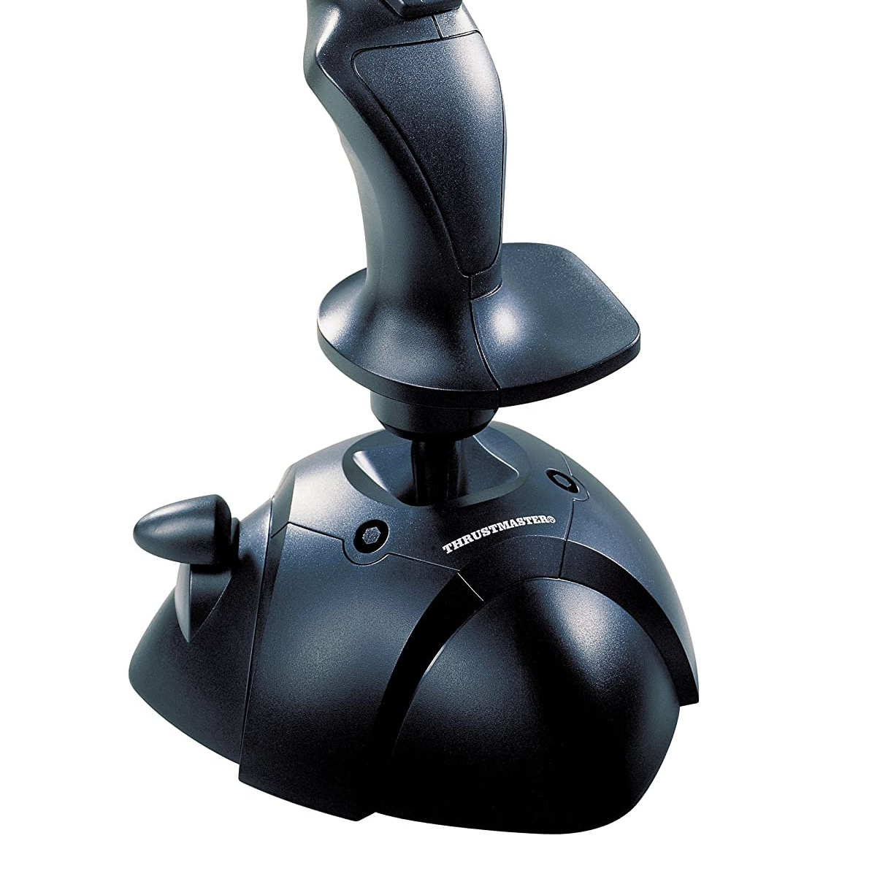
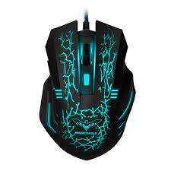
INPUT DEVICES
A piece of computer hardware apparatus used to supply a data processing system including a computer or information device with control and data signals.
Examples:
1.Joystick
2.Mouse
3.Webcam

Slide 6
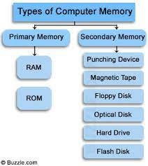
MEMORY UNITS
A memory unit is the amount of data that the memory can hold.
Memory unit is the amount of data that can be stored in the storage unit. This storage capacity is expressed in terms of Bytes.
2 types of memory units
1.Primary Memory
2.Secondary Memory

Slide 7
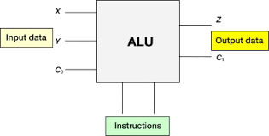
ALU
ALU means ARITHMETIC LOGIC UNIT
The ALU is that functional part of the digital computer that carries out arithmetic and logic operations on machine words that represent operands.

Slide 8
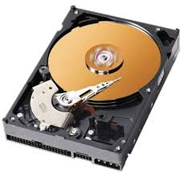
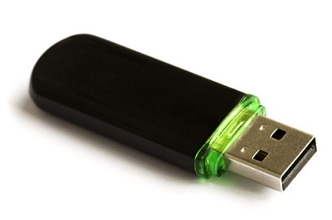
SECONDARY STORAGE UNITS
A secondary storage device refers to any non-volatile storage device that is internal or external to the computer.
It can be any storage device beyond the primary storage that enables permanent data storage
Example :
1.Hard Disk
2.CD/DVD
3.Pen/Flash drive

Slide 9

THANK YOU

